Slide 1
Software Testing Introduction CS 4501 / 6501 Software Testing

Slide 2

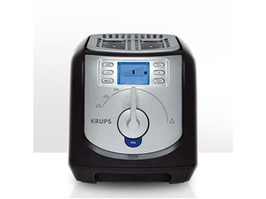

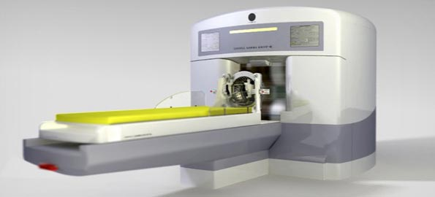
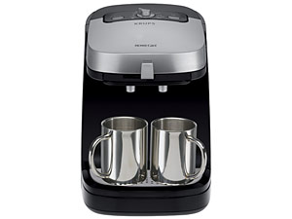
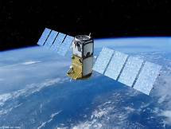


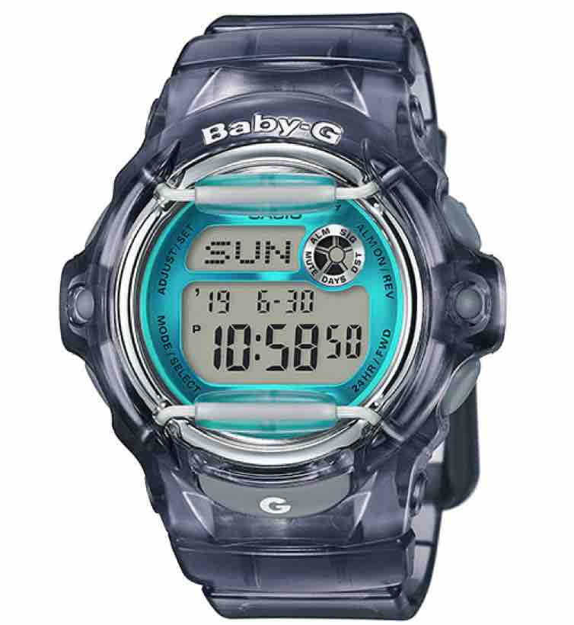
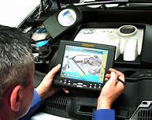

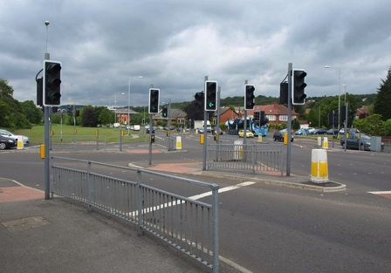

Software is Everywhere

Slide 3
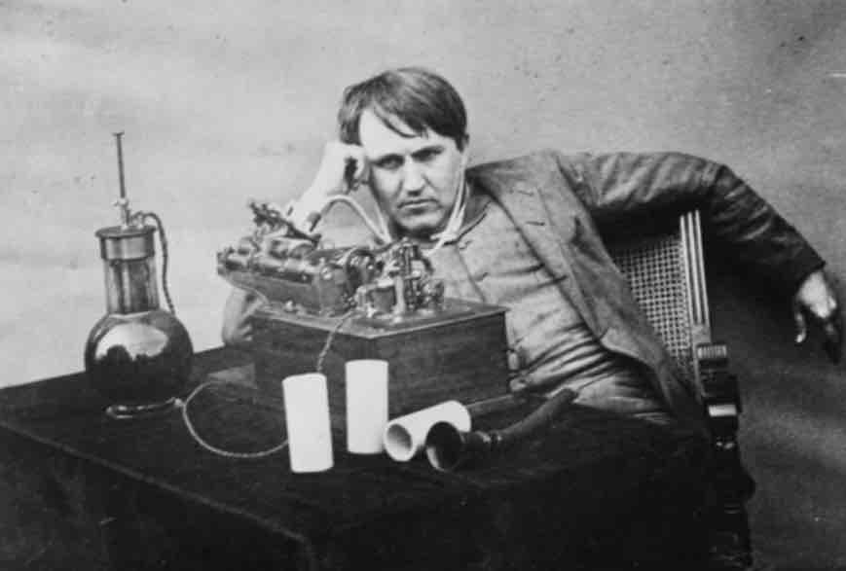
Bug?
“ ‘Bug’ – as such little faults and difficulties are called – show themselves, and months of anxious watching, study, and labor are requisite before commercial success – or failure – is certainly reached.” [Thomas Edison, 1878]
[Did You Know? Edison Coined the Term “Bug”, http://theinstitute.ieee.org/tech-history/technology-history/did-you-know-edison-coined-the-term-bug, IEEE 2013]
Bug is used informally.
Fault? Error? Or failure?
This course will try to use words that have precise, defined, and unambiguous meaning
BUG
Notes:
http://theinstitute.ieee.org/tech-history/technology-history/did-you-know-edison-coined-the-term-bug

Slide 4
Fault, Error, and Failure
Fault: a static defect in the software’s source code
Cause of a problem
Error: An incorrect internal state that is the manifestation of some fault
Erroneous program state caused by execution of the defect
Failure: External, incorrect behavior with respect to the requirements or other descriptions of the expected behavior
Propagation of erroneous state to the program outputs
Notes:
We’ll revisit these terms in detail

Slide 5
Software Failures
2016: Nissan recalled 4 millions cars from the market due to software failure in the airbag sensory detectors.
2016: Information lost after clicking the back button while using TurboTax web software
2015: Bloomberg’s trading terminal failures forced the British government to postpone $4.4 billion debt sale
2014: Dropbox’s outage was due to a fault in a maintenance script
2012: Faults in a new Knight Capital’s trading software causes $440 millions
2003: Northeast blackout: The alarm system in the energy management system failed due to a software error and operators were not informed of the power overload in the system – affected 40 million people in 8 US states, 10 million people in Ontario, Canada
1999: NASA’s Mars lander crashed due to a unit integration fault
1997: Ariane 5 explosion: Exception-handling bug forced self-destruct on maiden flight (64-bit to 16-bit conversion), causing $370 millions

Slide 6
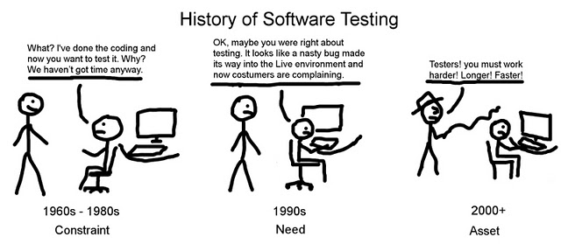
How Important is Testing?

Slide 7
Testing in the 21st Century
Safety critical, real-time software
Embedded software
Enterprise applications
Security
Web
Mobile
Software testing is getting more important
What are we trying to do when we test ?
What are our goals ?

Slide 8
What is Software Testing?
Testing = process of finding input values to check against a software (focus of this course)
Debugging = process of finding a fault given a failure
Test case consists of test values and expected results
Test values
(inputs)
Program
Actual results
vs
Expected results
Testing is fundamentally about choosing finite sets of values from the input domain of the software being tested
Given the test inputs, compare the actual results with the expected results

Slide 9
Validation and Verification (IEEE)
Validation : The process of evaluating software at the end of software development to ensure compliance with intended usage
Not done by developers, but by experts in the intended usage of the software
Verification : The process of determining whether the products of a given phase of the software development process fulfill the requirements established during the previous phase
Requires technical background on the software, normally done by developers at the various stages of development
IV&V stands for “independent verification and validation”

Slide 10
Testing and SW Development Lifecycle
Requirements
Analysis
Acceptance
Test
Validation
Test
Design
Information
Architectural
Design
System
Test
Subsystem
Design
Integration
Test
Detailed
Design
Module
Test
Verification
Implementation
Unit
Test
[AO, p.23]

Slide 11
Quality Checking and Quality Assurance
Quality Checking (QC)
Focus on defects identification
Product-oriented
Intend to make sure that results are as expected
Quality Assurance (QA)
Try to prevent defects
Focus on processes that assure the quality is built-in
Make sure that correct things are done in the correct way

Slide 12
Testing Goals Based on Test Process Maturity
Beizer’s scale for test process maturity
Level 0: There is no difference between testing and debugging
Level 1: The purpose of testing is to show correctness
Level 2: The purpose of testing is to show that the software
does not work
Level 3: The purpose of testing is not to prove anything
specific, but to reduce the risk of using the software
Level 4: Testing is a mental discipline that helps all IT
professionals develop higher quality software
[AO, p.9]

Slide 13
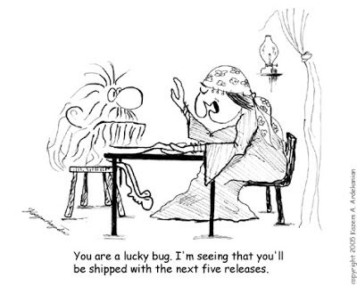
Level 0 – Debug Only?
Level 0: Testing is the same as debugging
Not distinguish between incorrect behavior and mistakes in the program
Not help develop software that is reliable

Slide 14
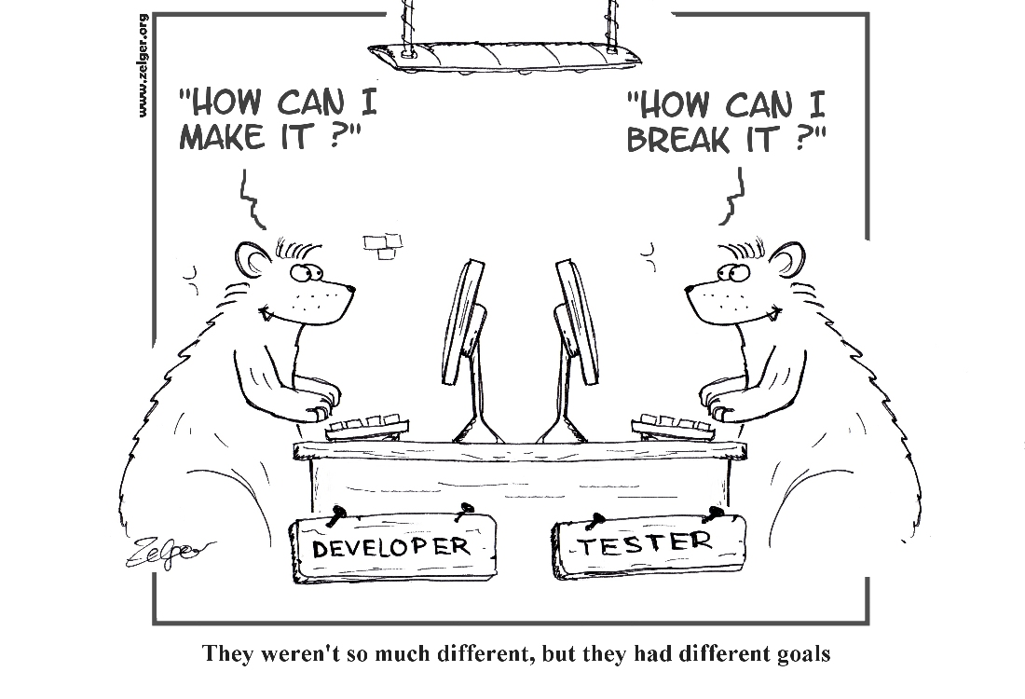
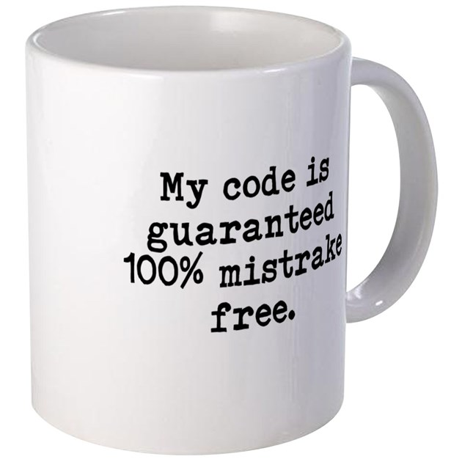
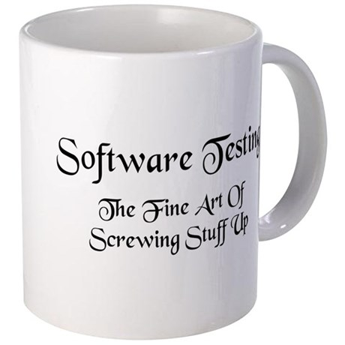
Levels 1, 2 – Developer vs Tester?
Level 1: Purpose is to show correctness (developer-biased view)
Correctness is impossible to establish or demonstrate
Level 2: Purpose is to show failure (tester-biased view)
A negative view puts testers and developers into an adversarial relationship

Slide 15
Levels 3, 4 – “Mature” Testing
Level 3: Purpose is to show the presence of failures
There are risks when using software
Testers and developers cooperate to reduce risk
Level 4: Purpose is to increase quality of the software
Testing should be an integral part of the development process
Testers and developers cooperate to improve the software quality
How mature is your testing?
Are you at level 0, 1, 2, or 3?
We hopes to teach you to become “change agents” (level 4)

Slide 16
Summary
Testing is the most time consuming and expensive part of software development
Not testing is even more expensive
Having too little testing effort early increases the testing cost
Planning for testing after develop is prohibitively expensive
A tester’s goal is to eliminate faults as early as possible
Testing improves software quality, reduce cost, and preserve customer satisfaction

Slide 17
What’s Next?
Fault, error, Failure
Reachability, Infection, Propagation, and Revealability (RIPR) model

